Slide 1


High-Precision LLRF System
for the Upgrade of SXFEL
Chengcheng Xiao, Yiming Xu, Chenyu Wei, Wencheng Fang
Microwave Group
Shanghai Advanced Research Institute. CAS
Oct.13 2025, Newport News

Slide 2
OUTLINE
Introduction of SXFEL
Hardware Design
Frimware Design
Experiments performed at SXFEL

Slide 3
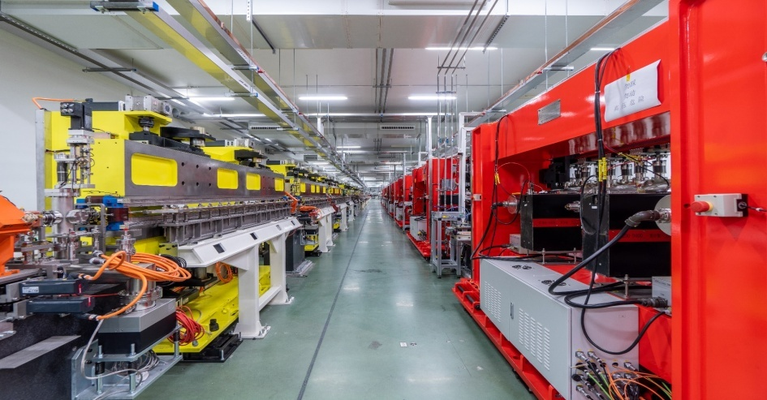
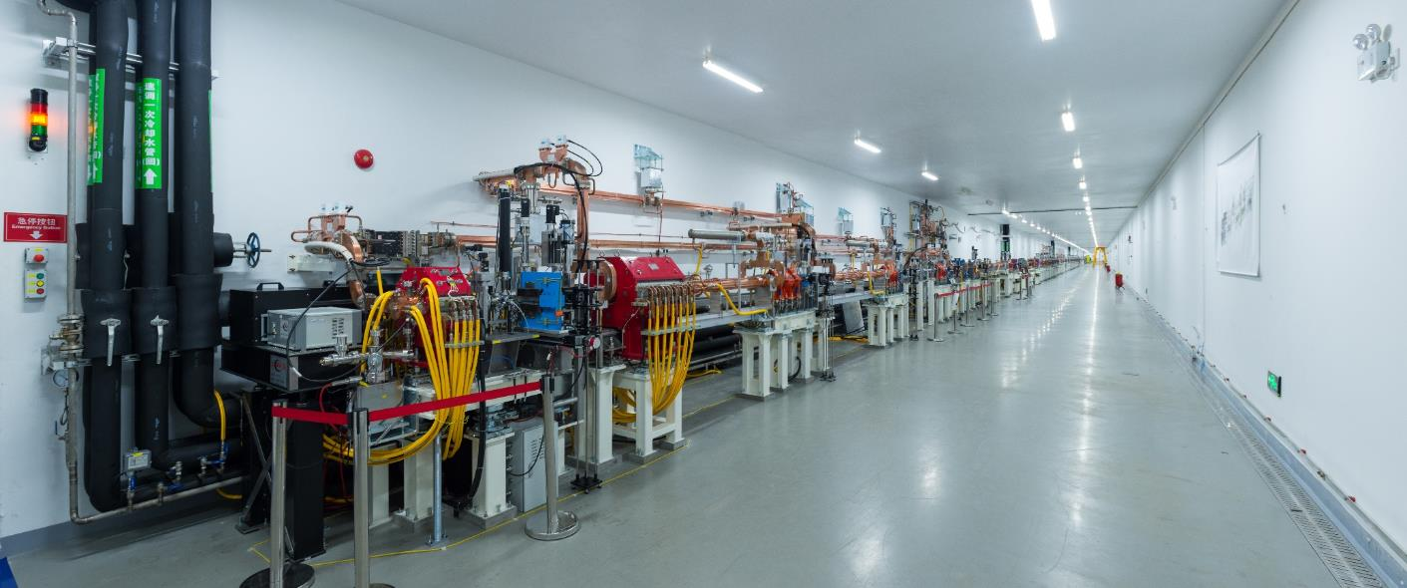

SSRF CAMPUS

Slide 4
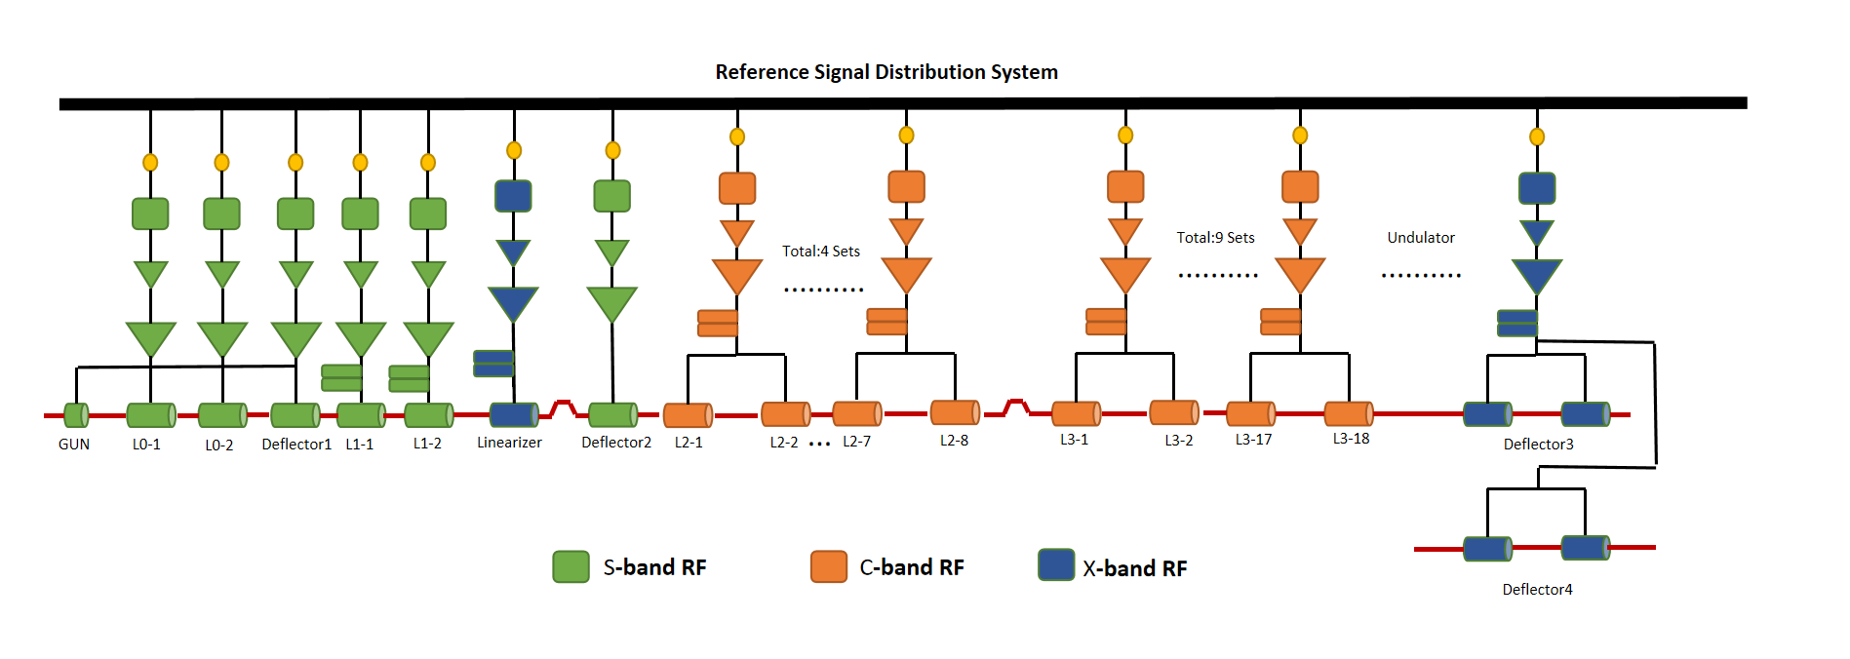
SXFEL LINAC
LINAC in SXFEL is composed of five S-band accelerating units, two S-band deflecting cavities, twelve C-band accelerating units, one X-band accelerating unit, one C-band deflecting cavity, and two X-band deflecting cavities. At the end of the linear accelerator, the beam reaches a final energy of 1.5 GeV
Accelerating Gradient
S band/ C band/ X band | 20MV/m 37MV/m 10MV/m
Voltage of Deflecting Cavity
S band/ C band/ X band | 2MV 10MV 20MV
Microwave stability
S band C band X band | 0.09º(rms)，0.04%(rms) 0.18º(rms)，0.04%(rms) 0.36º(rms)，0.04%(rms)
Pulse width | 0.1-5 uS
Repetition Rate | 1-50 Hz
Layout of SXFEL LINAC
Accelerating structure parameters

Slide 5
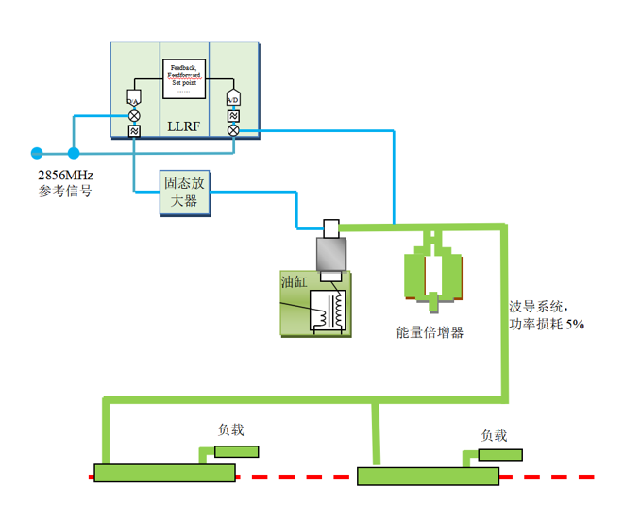
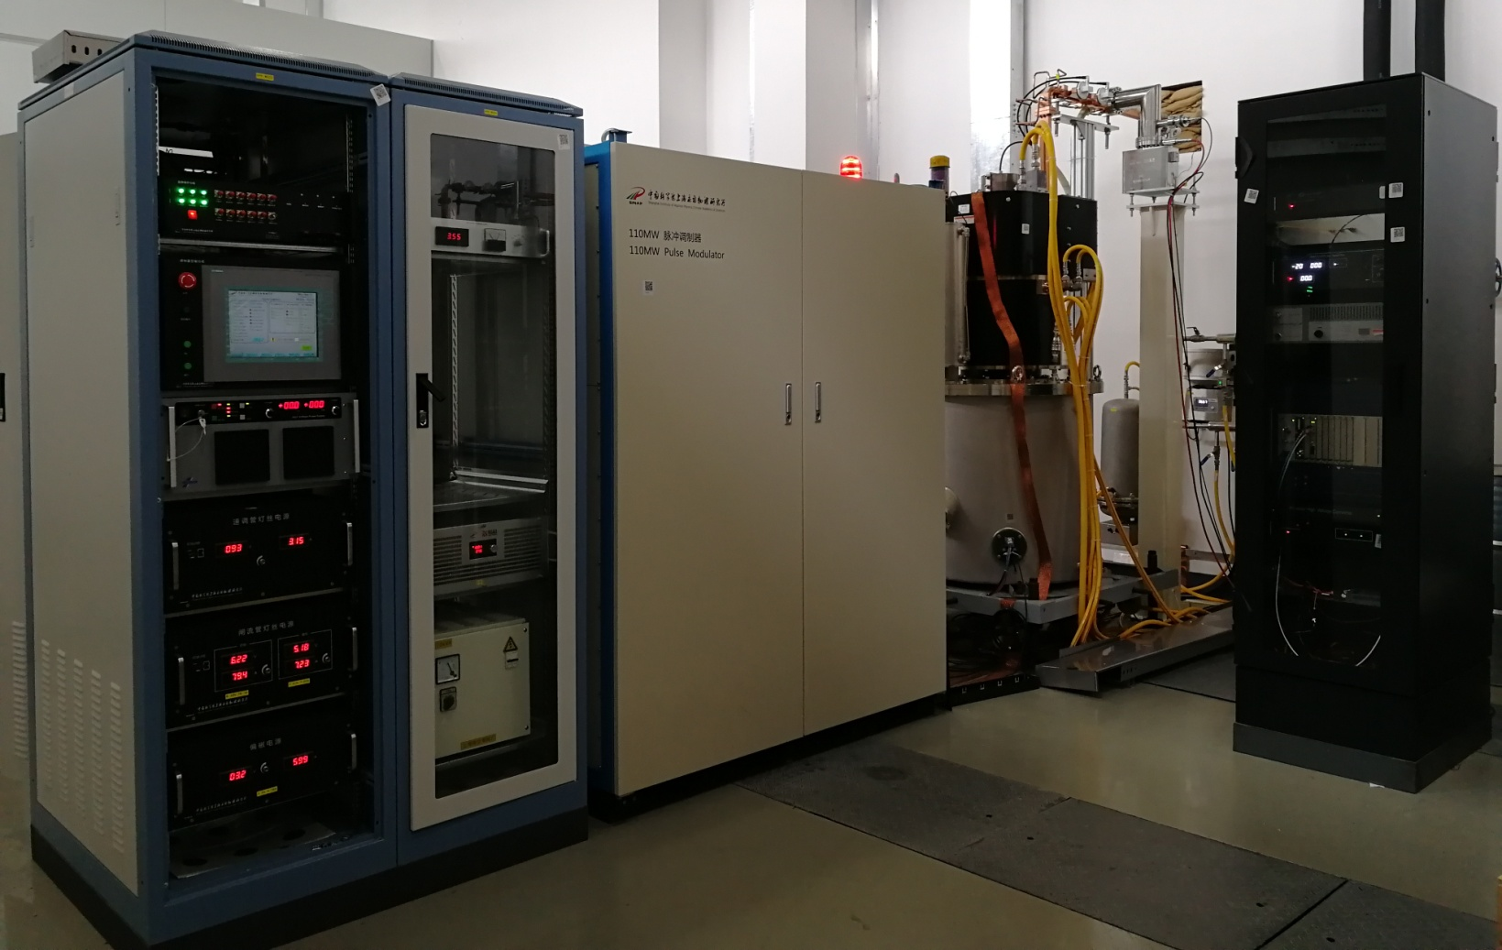
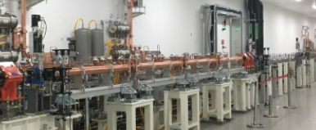
LLRF Subsystem
VM-modulated signal generated by the LLRF is first amplified by the solid-state power amplifier , then the output signal is amplified by a 50 MW klystron, subsequently boosted by the pulse compressor, and ultimately delivered to the accelerating structure
LLRF / SSA/ MODULATOR/ KLYSTRON
Microwave Subsystem

Slide 6
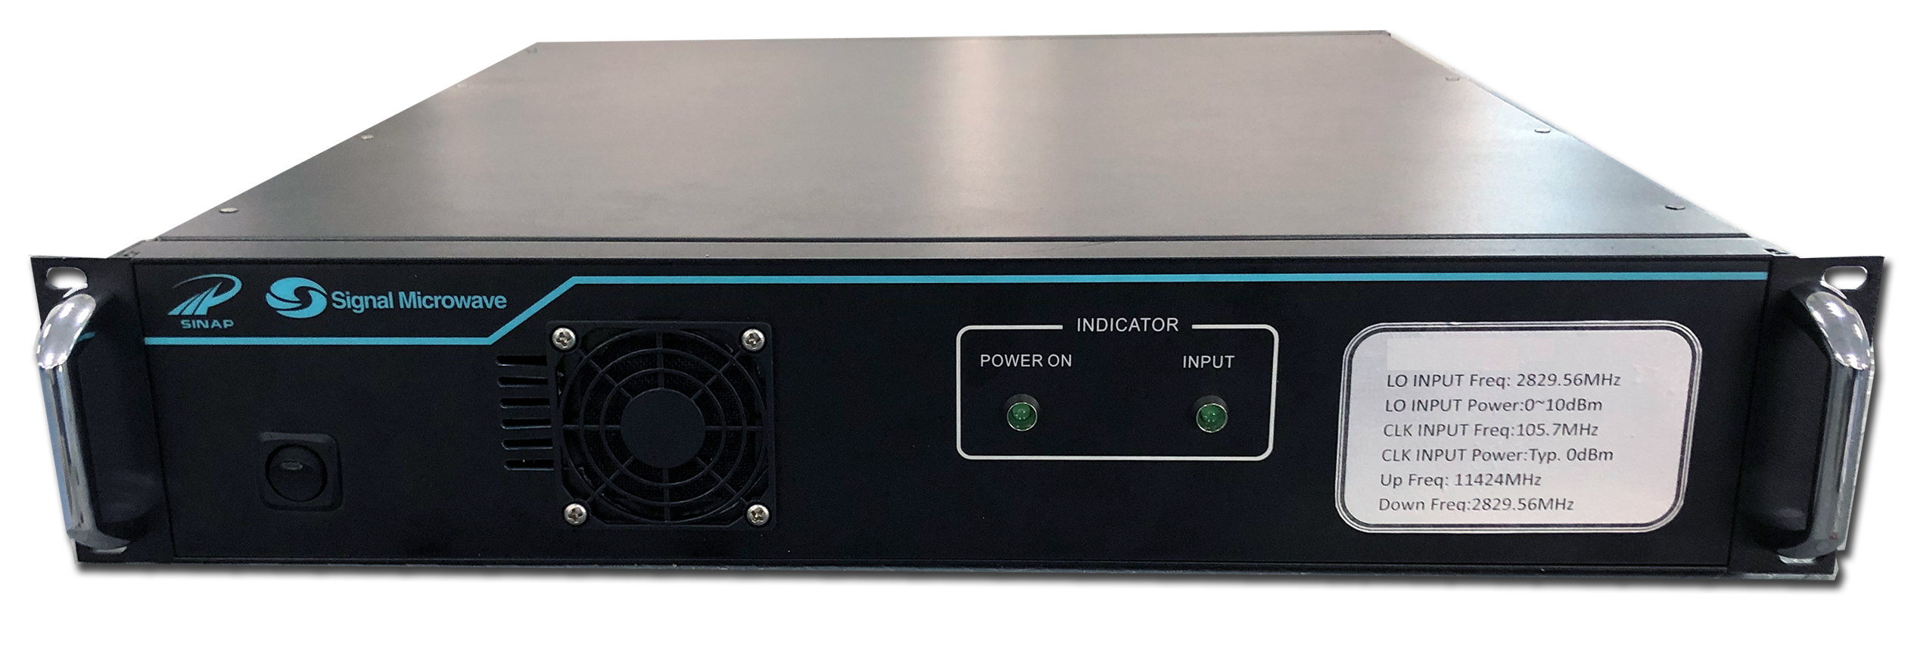
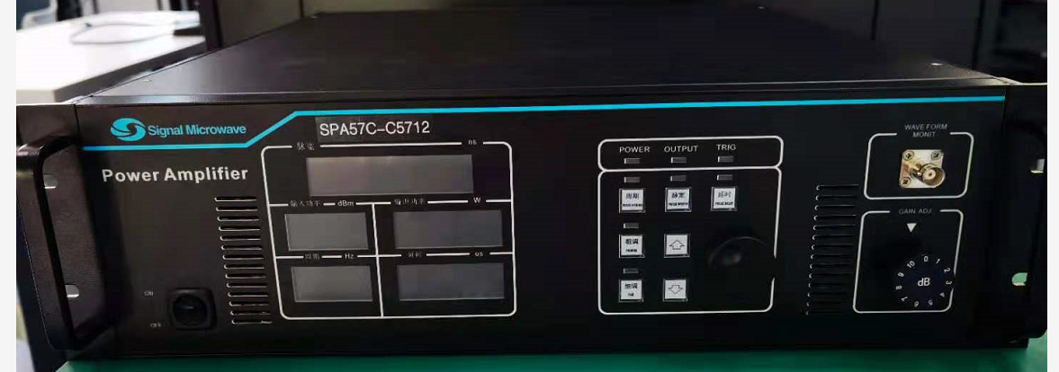
LLRF Subsystem
LO/CLK Generator
Solid State Amplifier
Function Description | Generation of Clock and LO signals
Reference Frequency | 2856 MHz/5712 MHz
LO | 2829.556 MHz/5685.556MHz
CLK | 105.77 MHz
LO Added Phase Jitter | ＜15 fs
CLK Phase Jitter | ＜100fs
Function Description | Provides driving power for the klystron
Working Frequency | 2856MHz /5712MHz
MAX power | 62 dBm/55 dBm
Stability | AMP 0.03%，PHA 0.03^{O} /AMP 0.03%，PHA 0.06^{O}

Slide 7
Hardware Design
SMA
LTC5562
8 RF down-conversion channels
Vector Modulator that drives DAC-generated I/Q signals with a reference source
The design achieves short-term amplitude stability better than 0.015%, while maintaining phase jitter below 25 fs (rms) within the 10 Hz–10 MHz offset range
IF
8 Channels
AC
LO
（VM）
IN
VM
IP
QN
Reference
QP
Frequency Mixer/ Vector Modulator

Slide 8
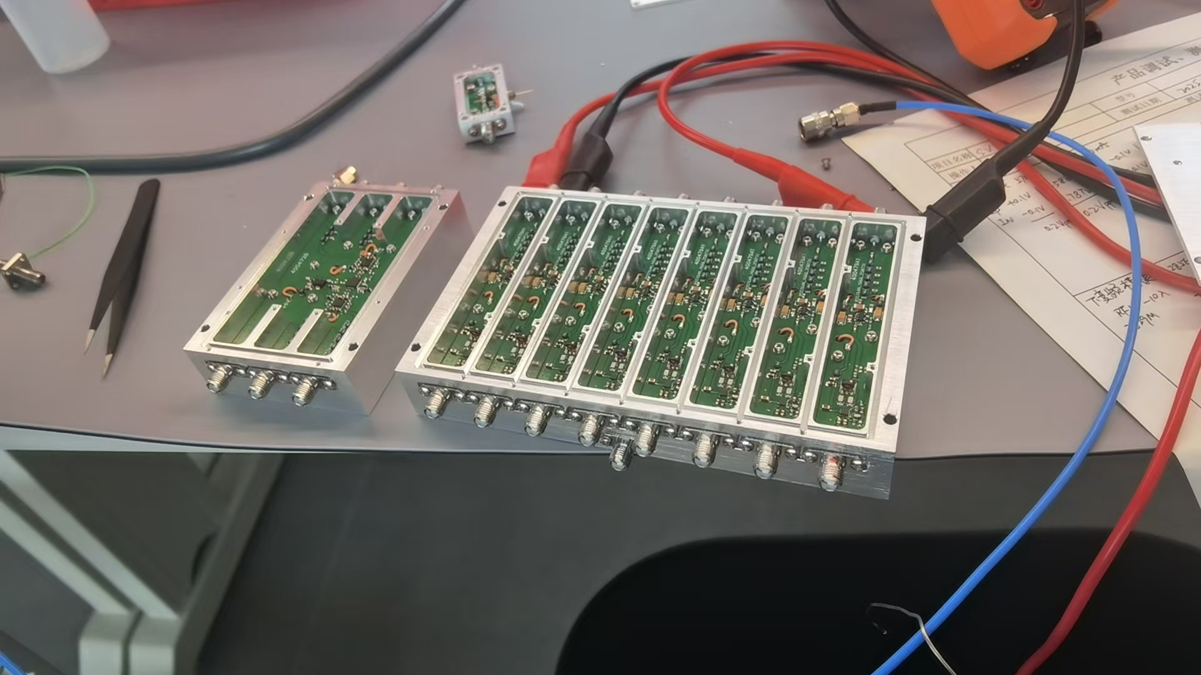
Hardware Design
Independent down-conversion modules and vector modulation (VM) modules
Metallic shielding is employed to secure inter-channel isolation exceeding 70 dB
Multi-stage low-pass filters are employed to suppress harmonic components
Rogers dielectric materials are utilized to support efficient and stable high-frequency signal transmission
Stabilized power supply modules are integrated to eliminate ripple-induced disturbances
Frequency Mixer/ Vector Modulator

Slide 9
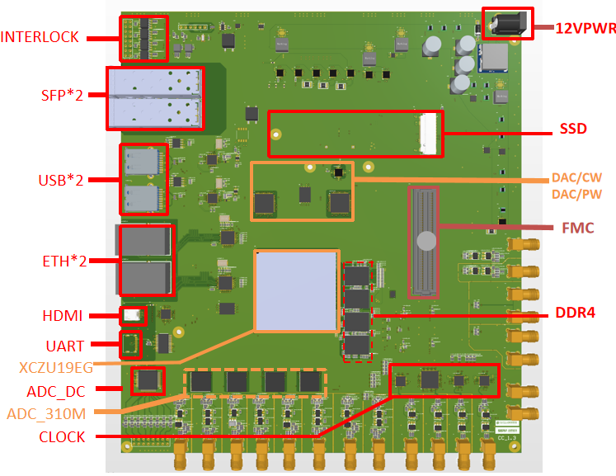
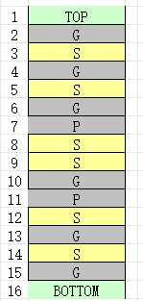
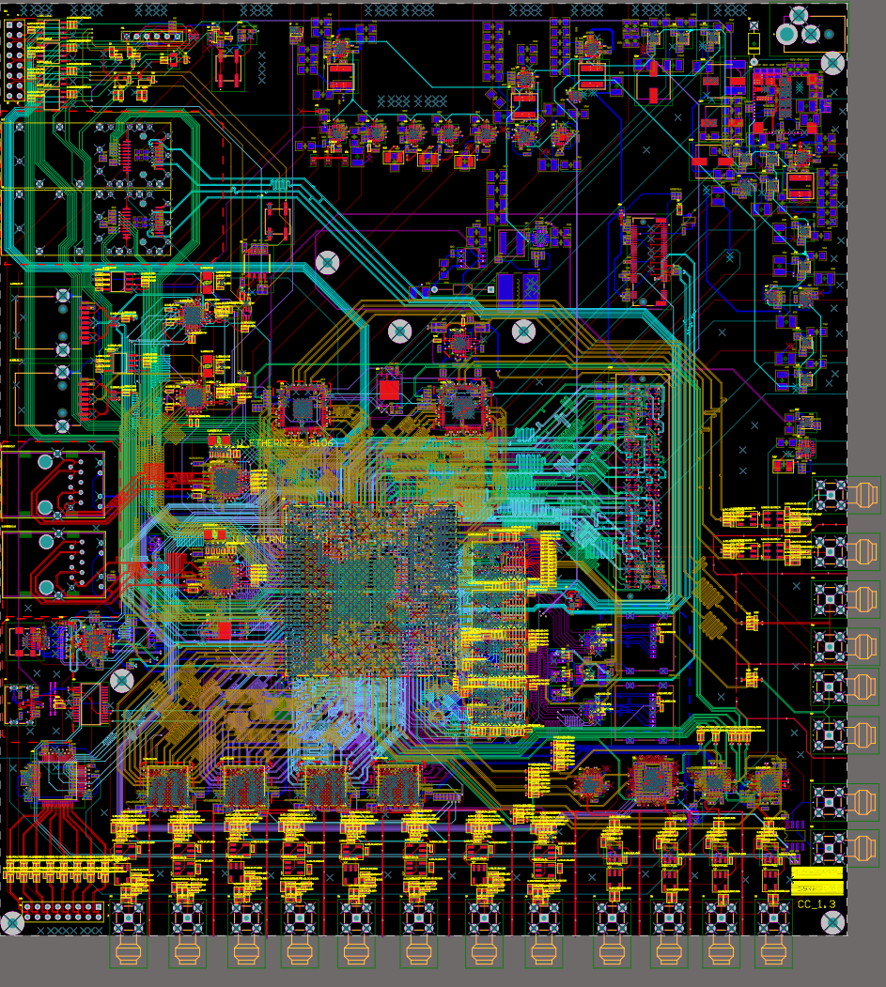
Hardware Design
DSP Board Design

Slide 10
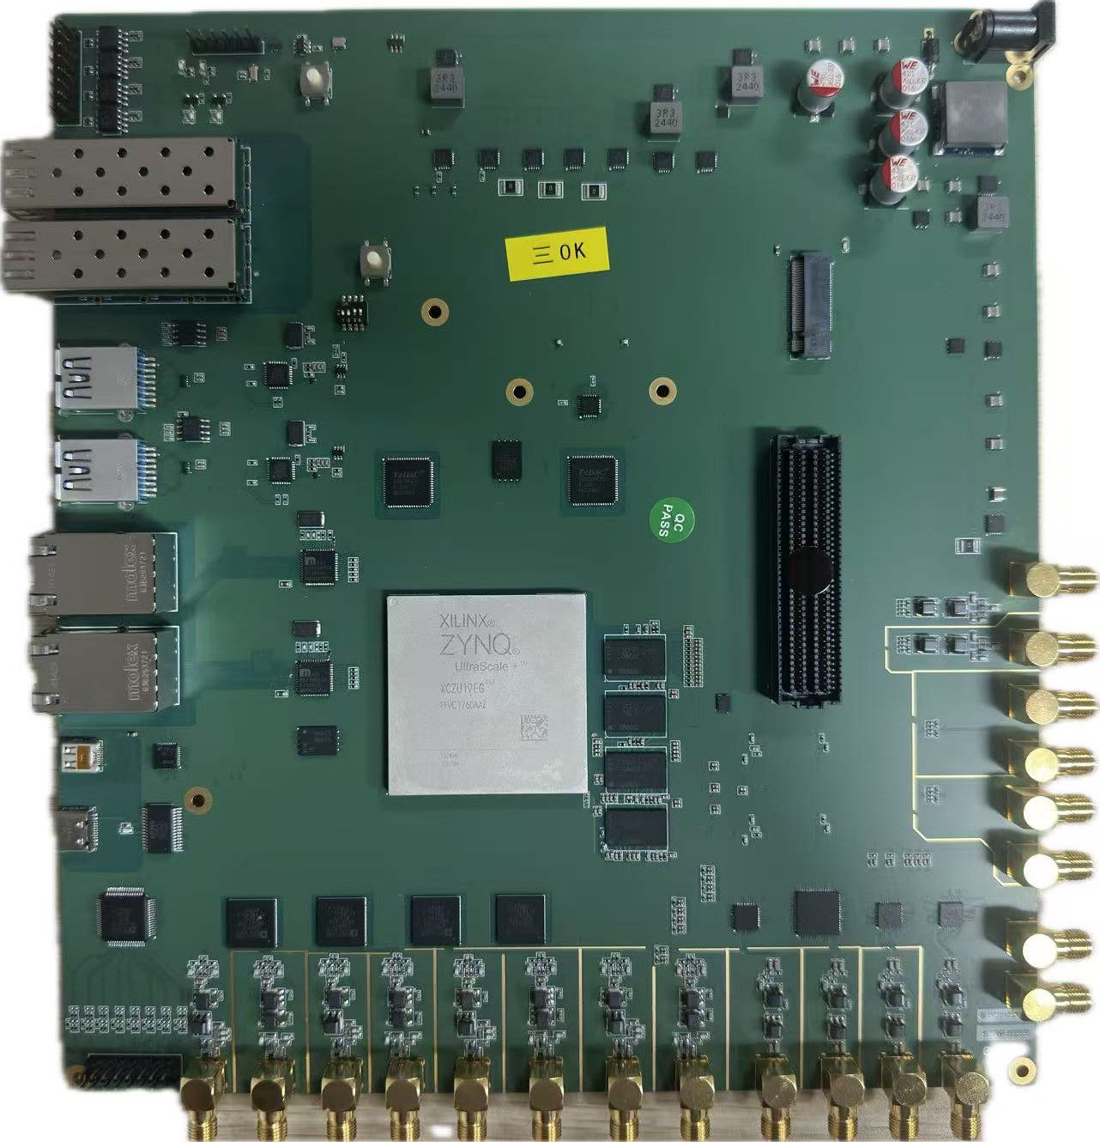
Hardware Design
16 Layers
Based on Zynq MPsoc
8-channel 310 MSPS 16bit ADCs
4-channel 500 MSPS 16bit DACs
8-channel DC ADC sampling
Seperate CLK distribution for ADC and DAC
FMC interface
SSD/micro SD
DSP board

Slide 11

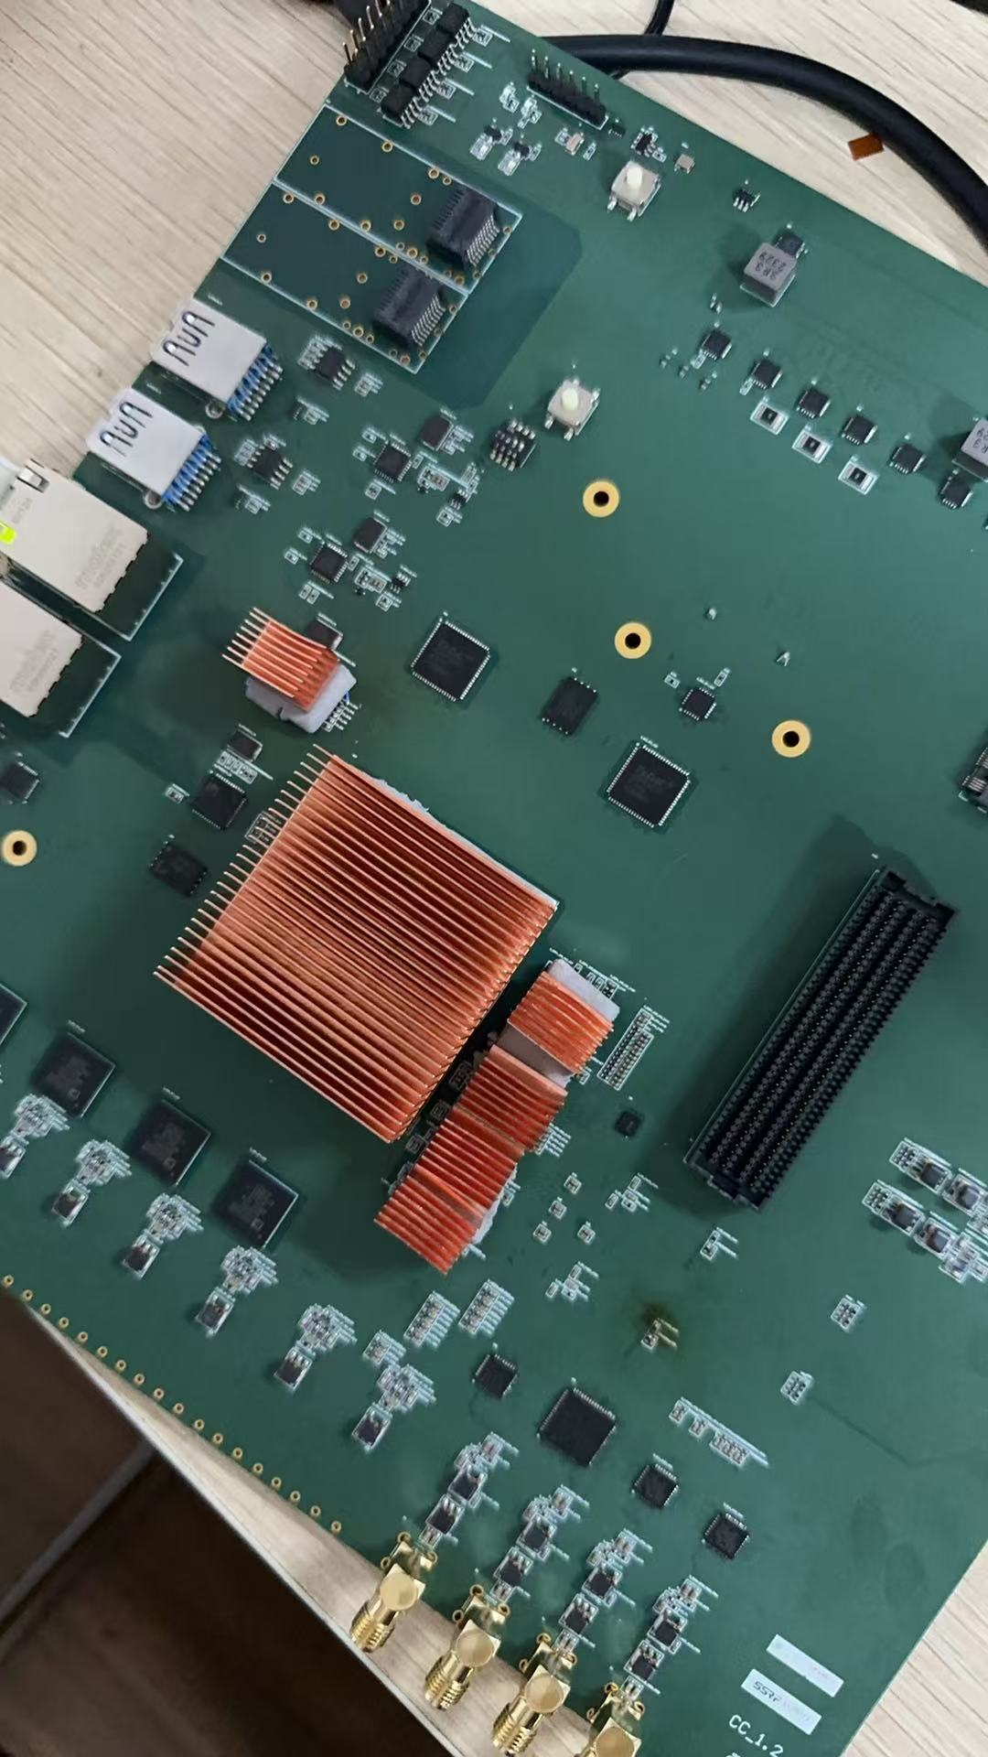
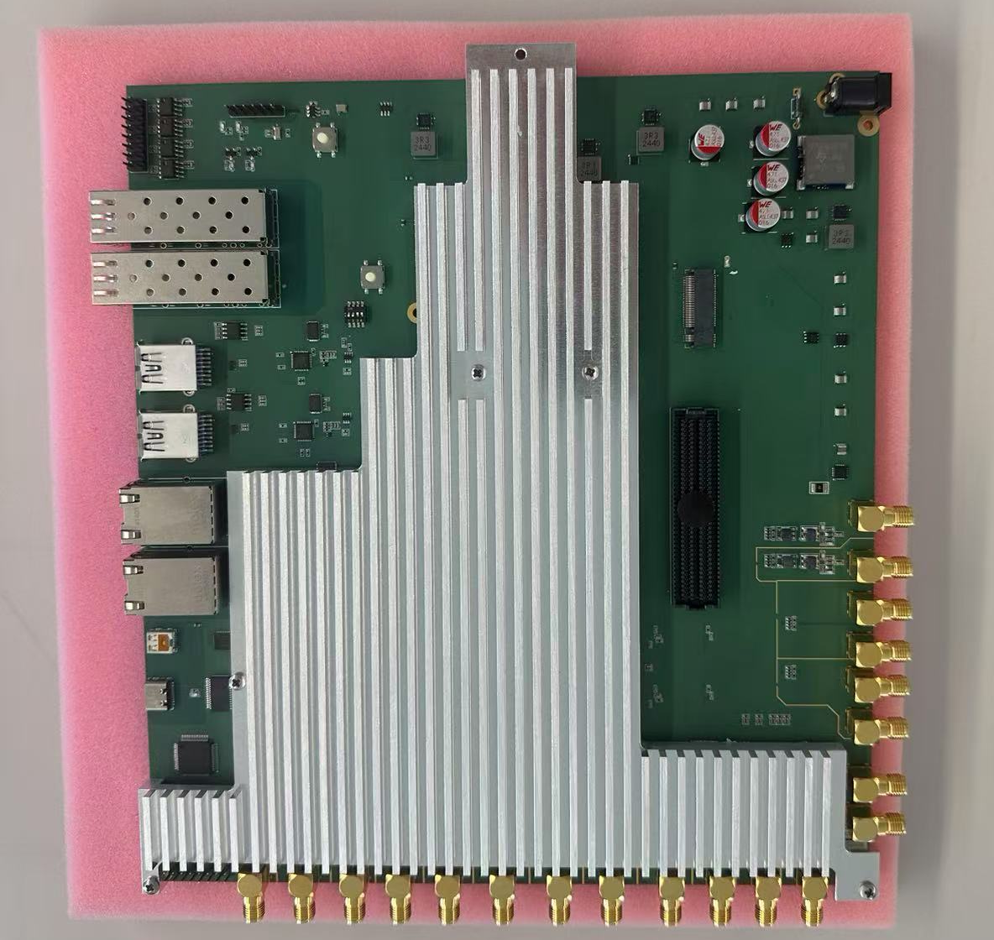
Hardware Design
FPGA
Power Management
Ethernet
ADCs
...
Cooling Matters!

Slide 12
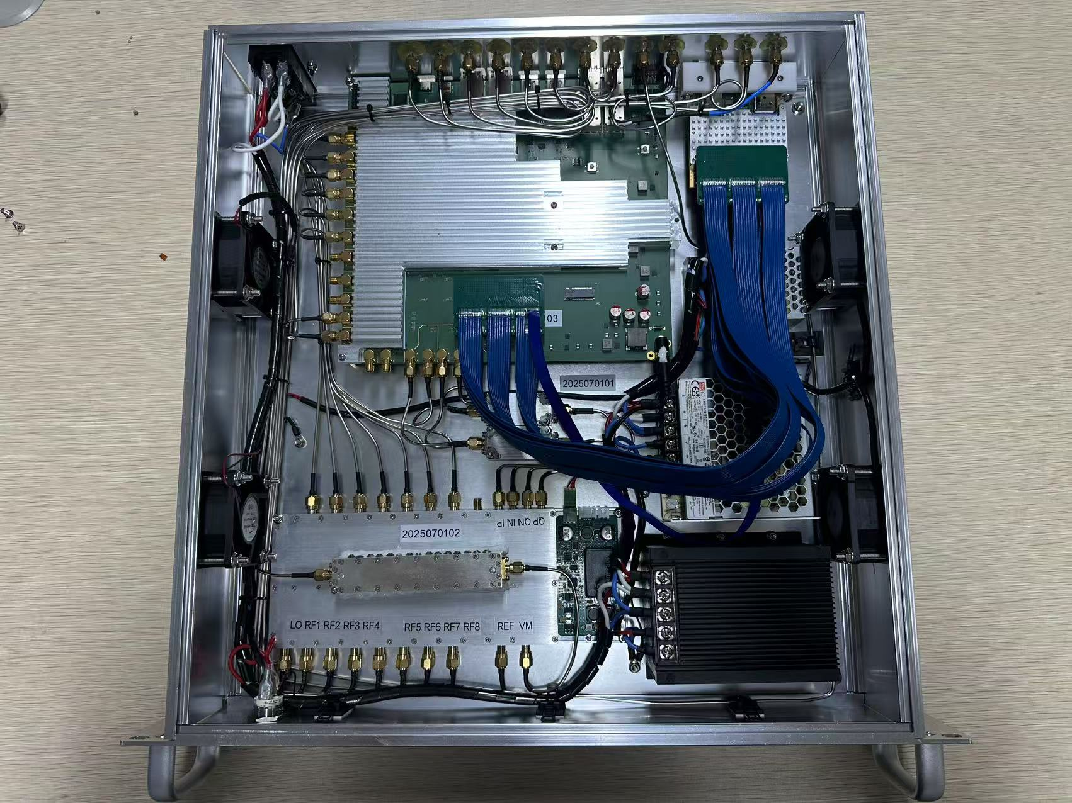
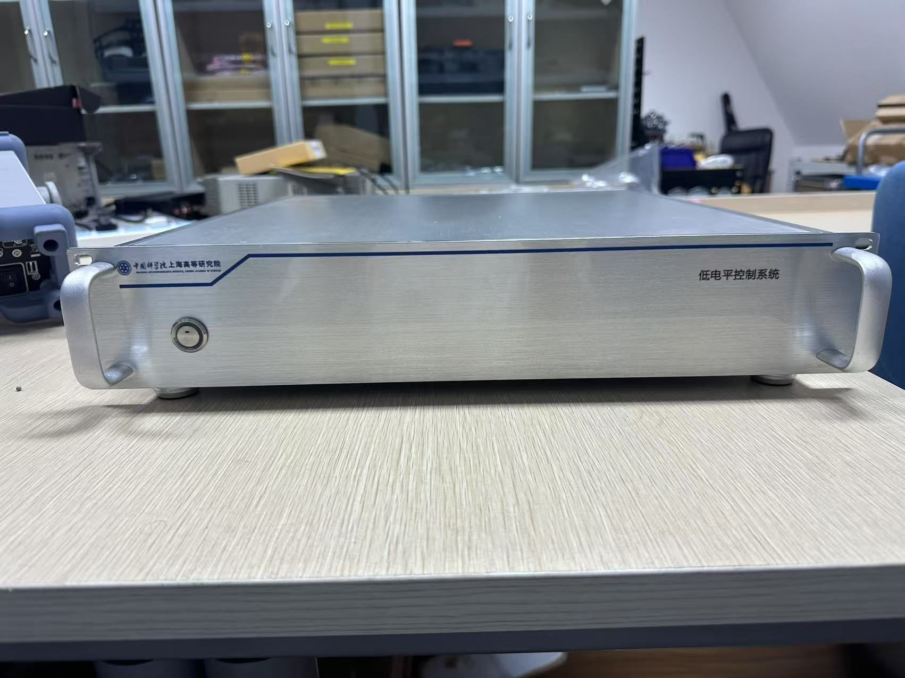
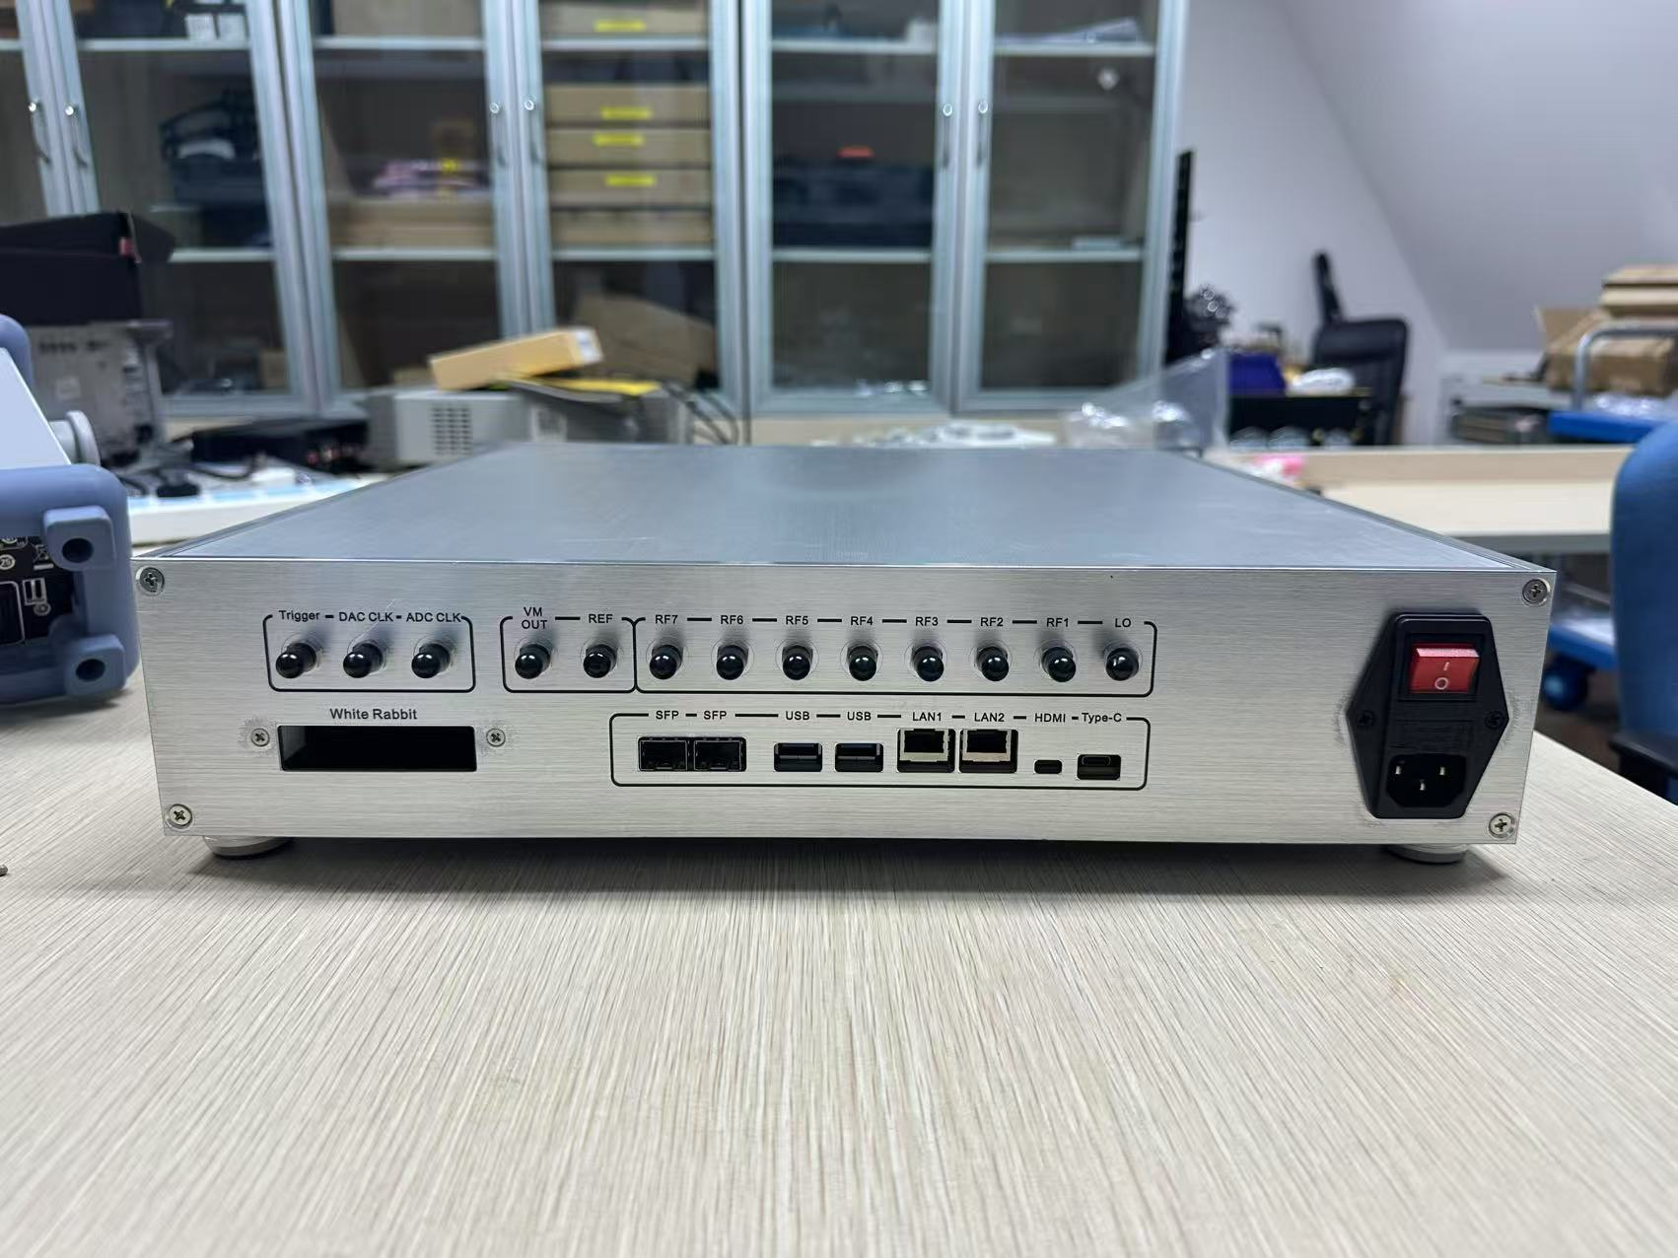
Hardware Design
DSP Board
WR Mezzanine Card
Frequency Mixer/ Vector Modulator

Slide 13
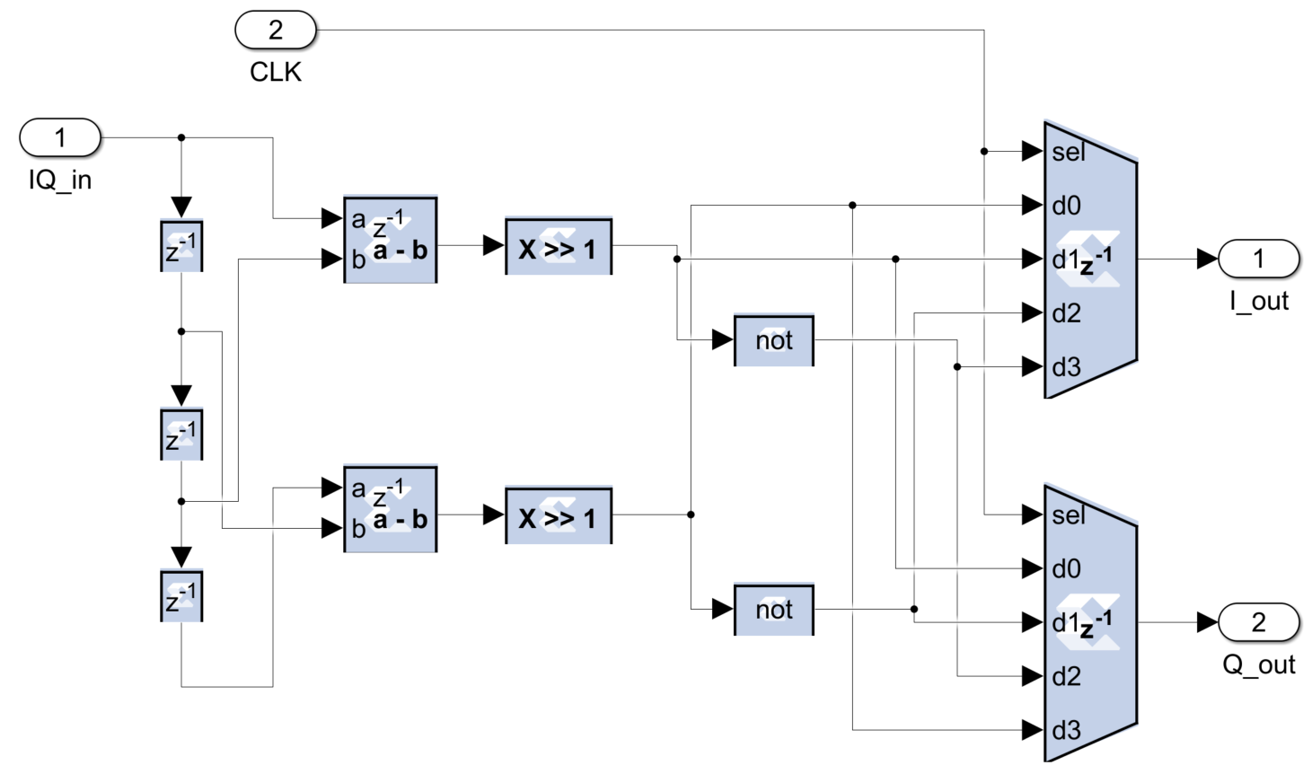
Firmware Design
SystemGenerator aided function design
SysGen automatically generates Verilog code according to schemtic
Running at 100-MHz CLK, same with the ADCs & DACs
Packaged module simplifies the design, so more attention is paid on the function and timing rather than data type
4 times pipeline IQ demodulator
Output I/Q component at 100 MHz

Slide 14
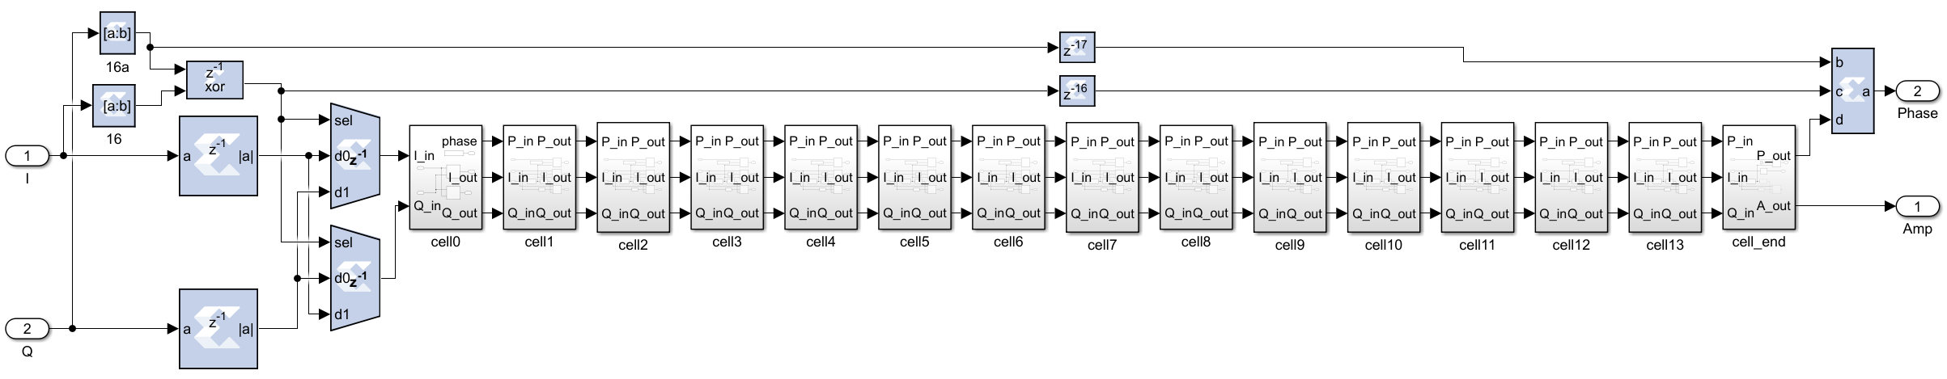
Firmware Design
16-bit AD/DA leads to 16-order real-time pipeline CORDIC
Output 15-bit amplitude and 17-bit phase at 100 MHz
Output is used by algorithms directly

Slide 15
Firmware Design
Multiple operation mode
Sel register controls the mode, which can be set online by Linux
Enhance flexibility and universality
Sel
0
1
Freq.
Bus
Σ
2
F-PLL
3
Sel
Mode | Function
0 | Turn off
1 | Continuous-wave PID control
2 | Continuous-wave PLL control
3 | Pulse-wave (repetition rate: 1~1000 Hz; Duty range: 0.01~100%)
4 | Feedforward table output of any waveform
… | To be continue
0
1
+
P-PID
Phase
Bus
+
2
+
P-set
3
I-offset
Sel
+
+
Phase
I
+
DA1
0
1
CORDIC
A-PID
Amp.
Bus
Amp.
Q
+
DA2
2
+
A-set
3
Q-offset
+
Modules of all modes are connected to 3 buses

Slide 16
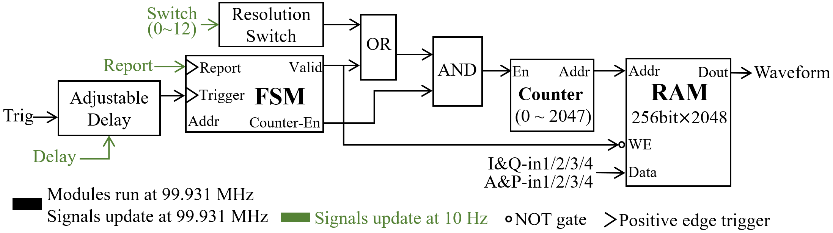
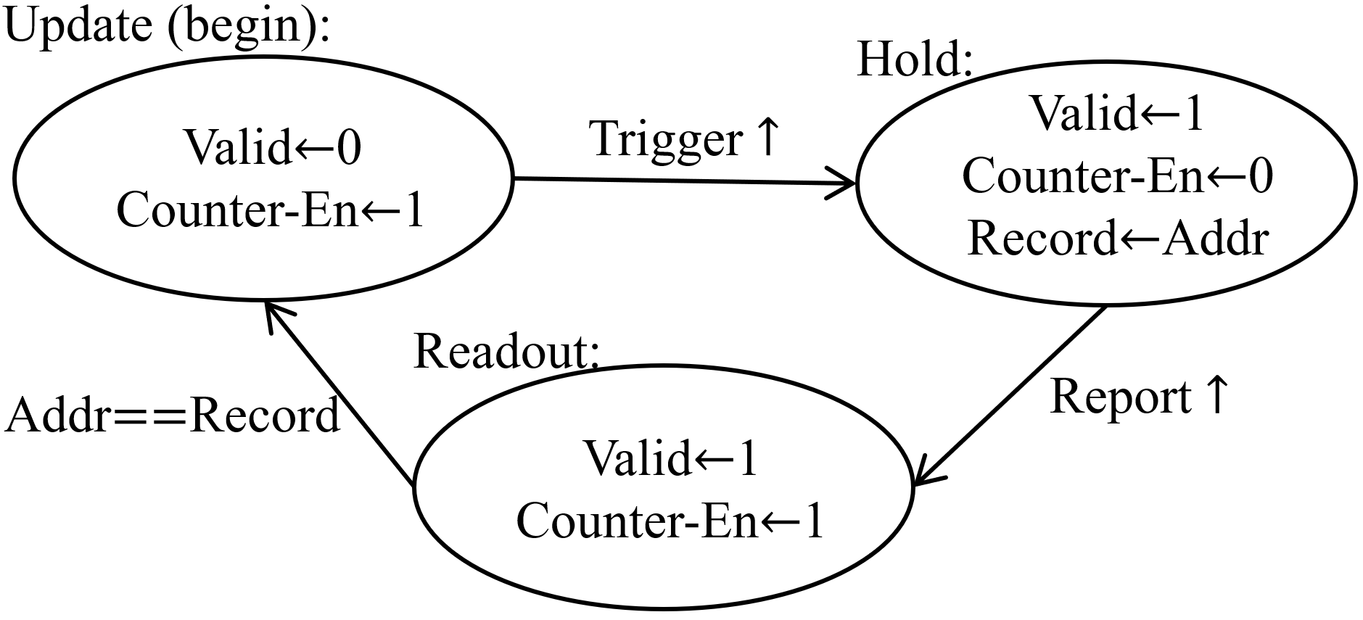
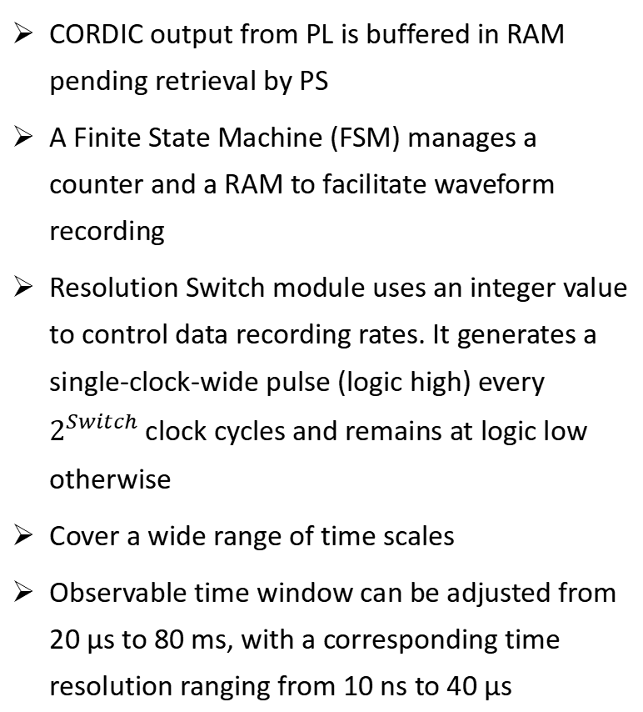
Firmware Design
CORDIC output from PL is buffered in RAM pending retrieval by PS
A Finite State Machine (FSM) manages a counter and a RAM to facilitate waveform recording
Resolution Switch module uses an integer value to control data recording rates. It generates a single-clock-wide pulse (logic high) every $2^{Switch}$ clock cycles and remains at logic low otherwise
Cover a wide range of time scales
Observable time window can be adjusted from 20 µs to 80 ms, with a corresponding time resolution ranging from 10 ns to 40 µs
Multi-resolution waveform recorder
State transition diagram of the FSM

Slide 17
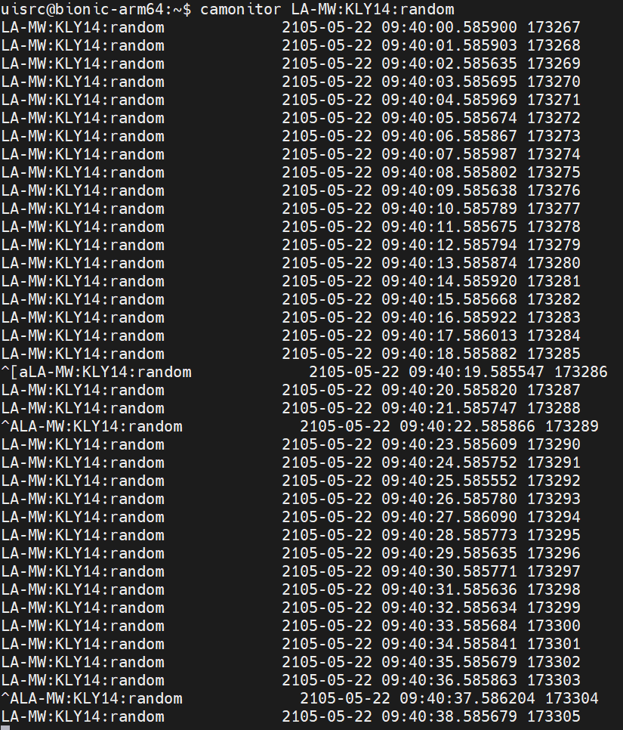
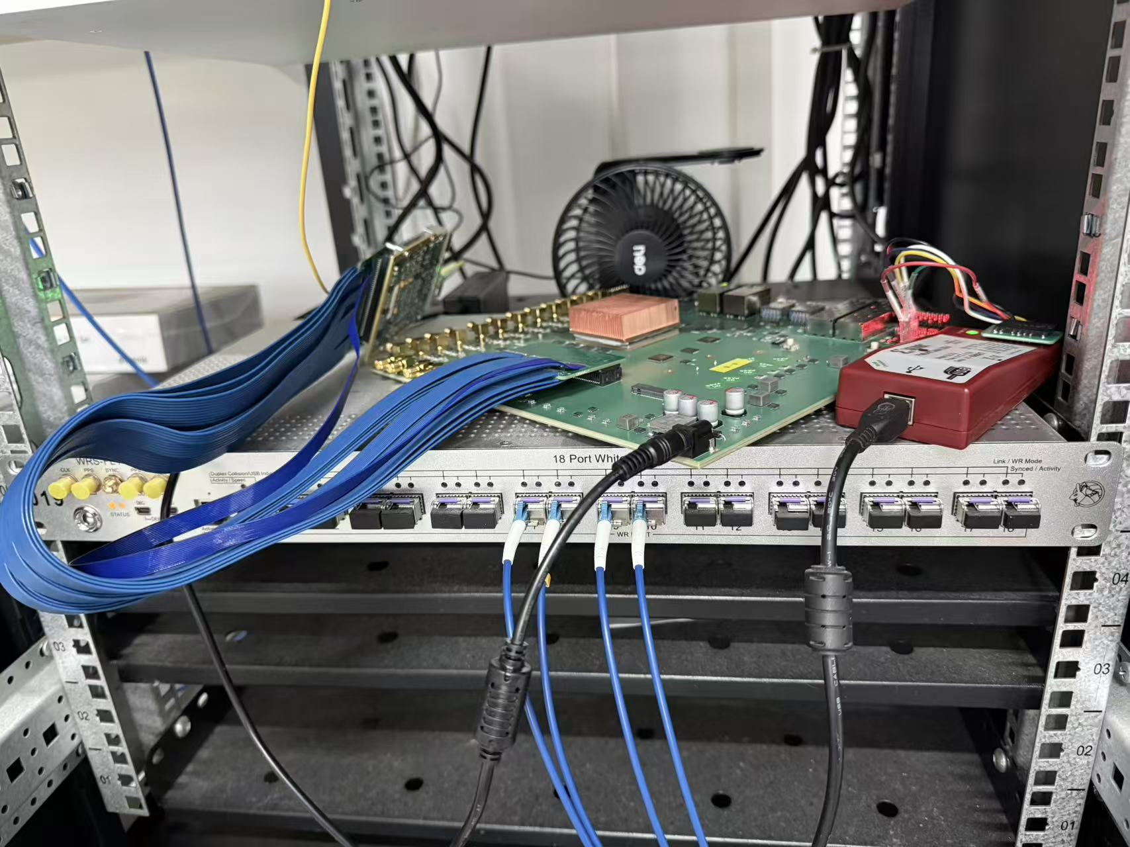
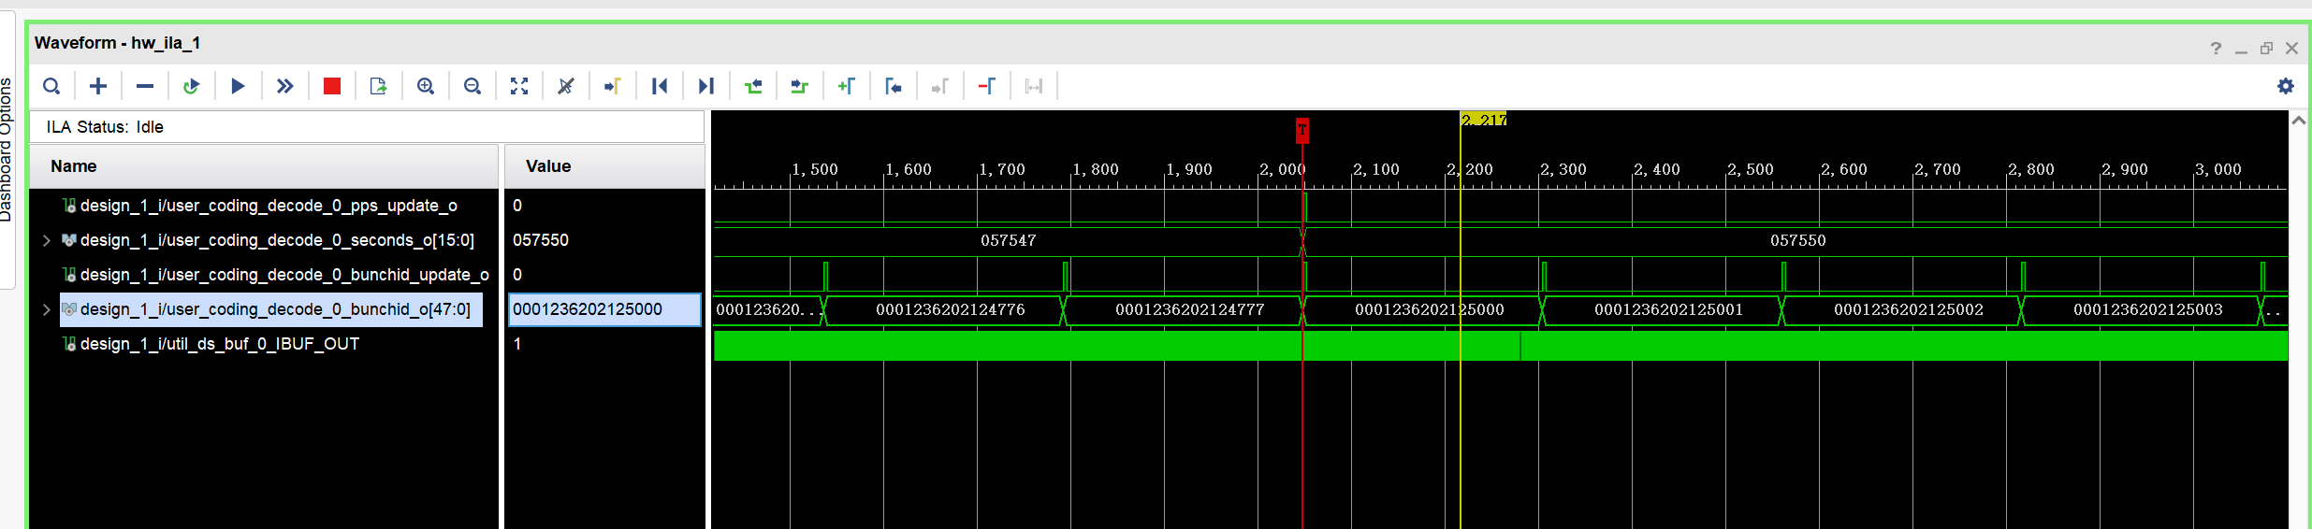
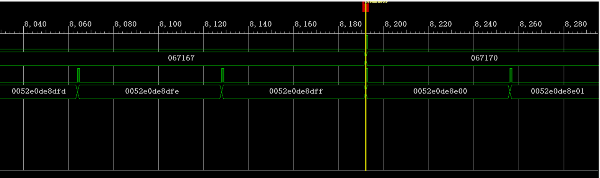
Experiments performed at SXFEL
Absolute time stamp is incorporated on a pulse-by-pulse basis, enabling seamless interfacing with the WR pulse, bunch ID, and timing information supplied by the control system
Time-stamp column replacement is applied to the PVs, thereby facilitating pulse-by-pulse diagnostics for beam commissioning personnel
WR Mezzanine Card Test
EPICS PV Edit
Pulse /Bunch ID in Vivado

Slide 18
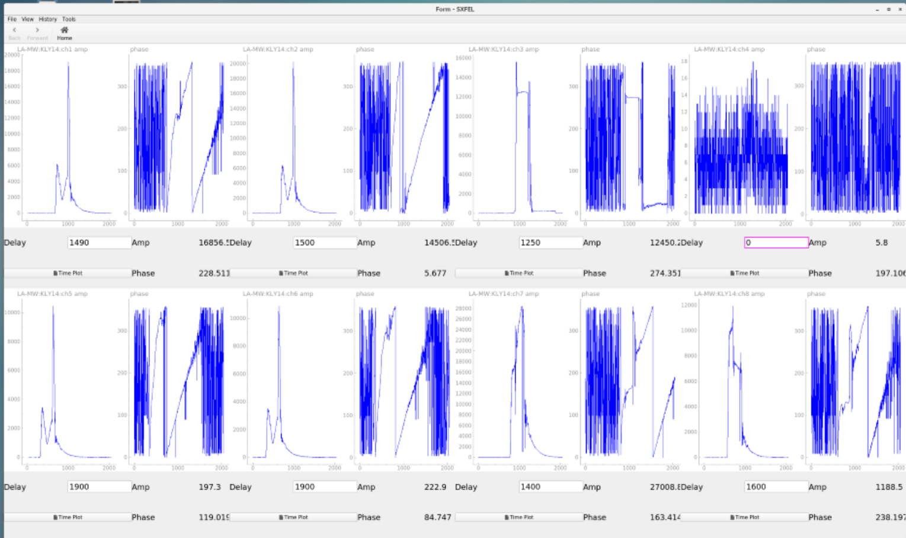
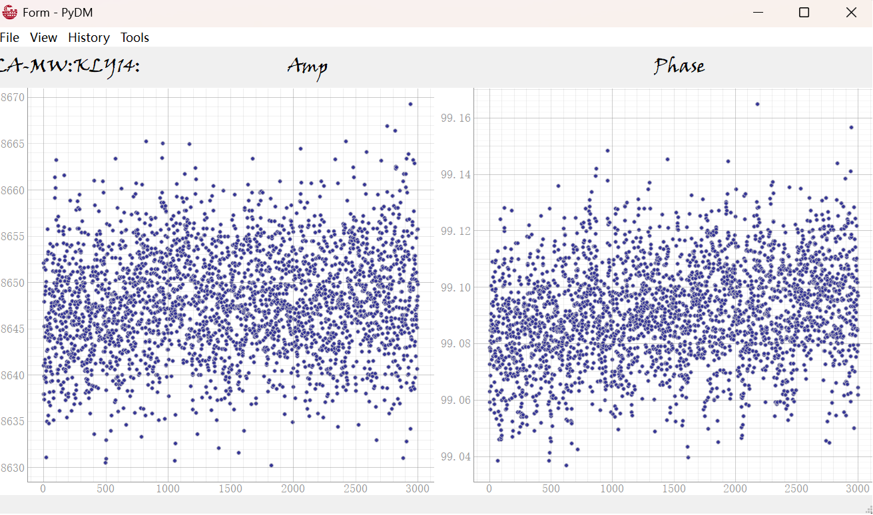
Experiments performed at SXFEL
Experimental results demonstrate that the VM output achieves amplitude stability better than 0.015% (RMS) and phase stability better than 0.015 degrees (RMS) under 5712 MHz
At the input of the accelerating structure, the measured amplitude stability is better than 0.03% (RMS), while the phase stability is better than 0.03 degrees (RMS)
PYDM interface
VM signal stability test(C band)

Slide 19
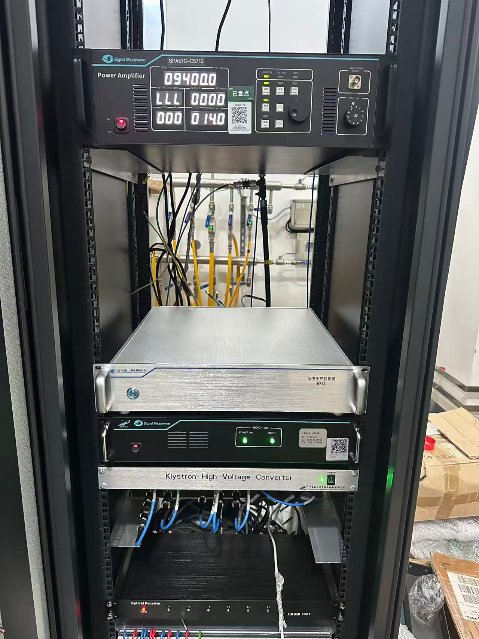
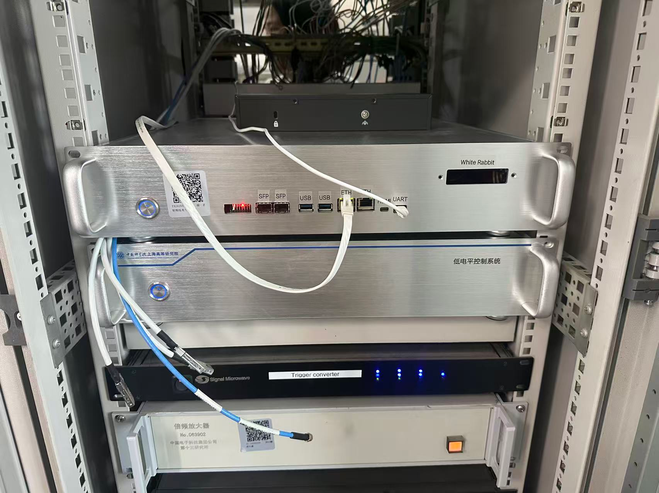
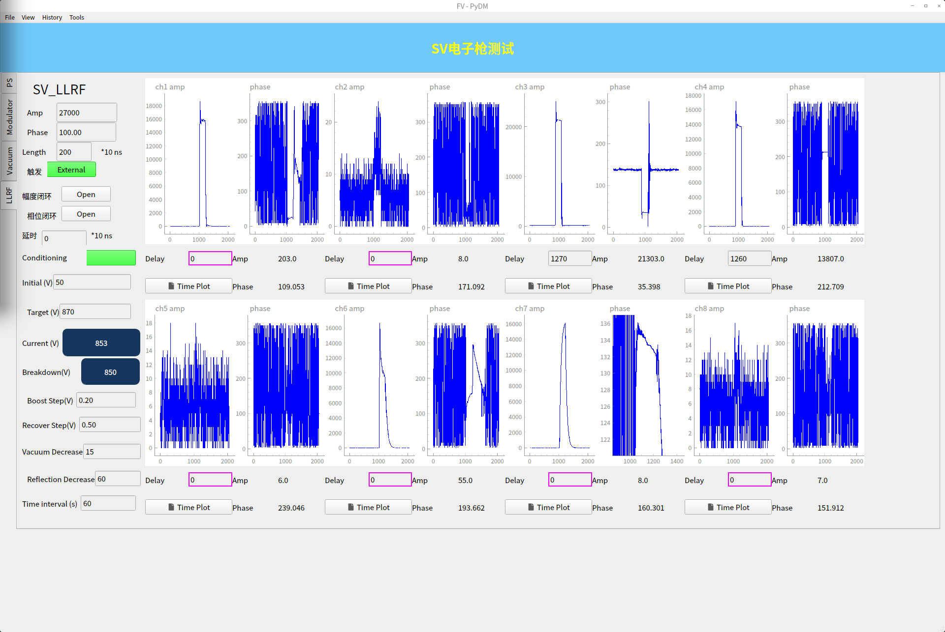
Experiments performed at SXFEL
S band LLRF in SSRF LINAC
S band LLRF in RF-Gun Test Stand
C band LLRF in SXFEL

Slide 20
Summary
New S/C band LLRF system was developed for SXFEL/SSRF facility and is working well
White Rabbit Compatible
High-performance, high-sampling-rate ADCs and DACs
Comprehensive range of interfaces
PS-PL instead of CPU-FPGA
X band LLRF system is under developing
Intra-pulse MPC control is under developing
Ongoing efforts are focused on exploring how AI can be integrated to enhance system’s capabilities

Slide 21

Thank you for your attention!

